Slide 1

COEN 6501-Digital System Design and Synthesis Fall-2021
Presented by Group R
Abdul Aziz Midthuru (40163297)
Abhishek Madhu (40193107)
Ragul Nivash Rangasamy Sekar (40169564)
Shivendra Arulalan (40197455)
Thenmozhie Rajan (40192527)

Slide 2
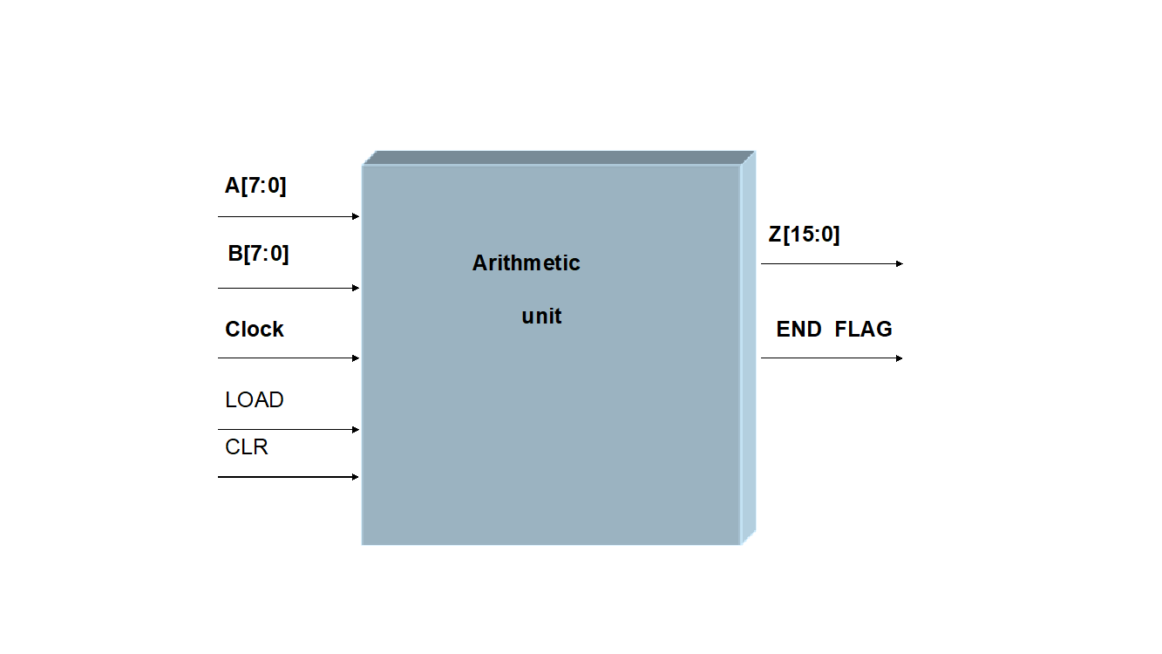
Arithmetic Unit Implementation which is capable of calculating Z = ¼ [A²*B] +1
Requirement number | Description | Comment
R1 | The choice of type of multiplier, is left to the student
R2 | The design shall be structural.
R3 | The operands A and B are latched into register RA and RB when LOAD signal transit from high to low.
R4 | The CLEAR signal will clear all registers to ‘0’.
R5 | The 16-bit product shall be loaded into the 16-bit Z port.
R6 | The unit performs the arithmetic operation until END_FLAG becomes high.

Slide 3
Using RCA and Wallace tree Multiplier
METHOD 1

Slide 4
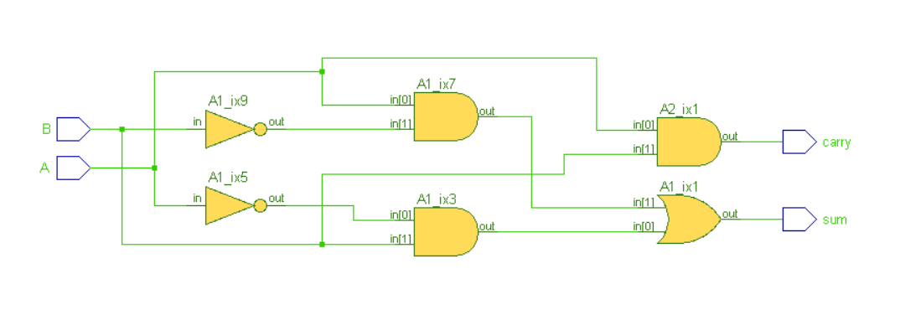
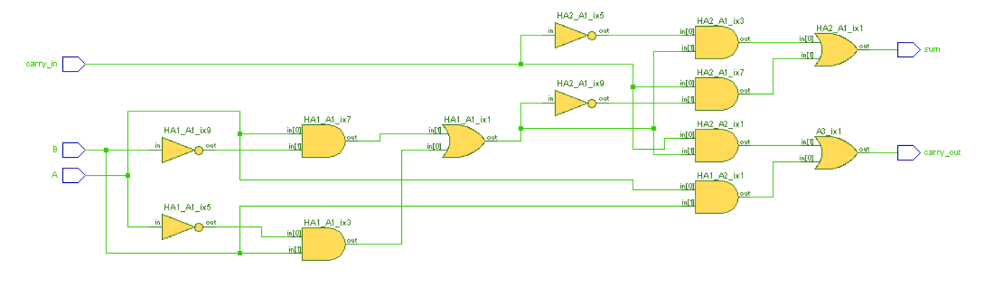
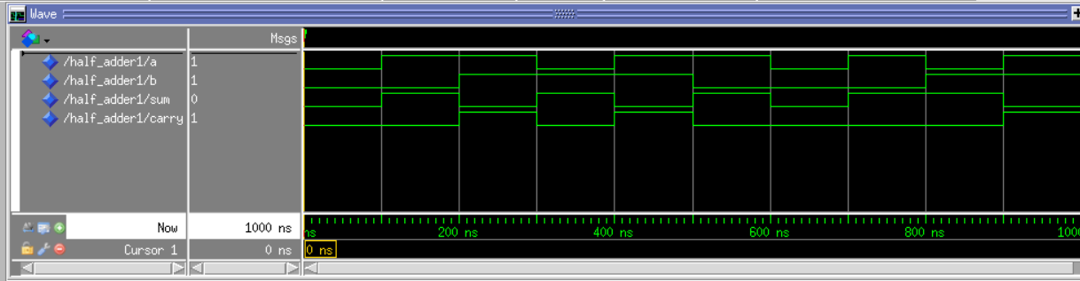
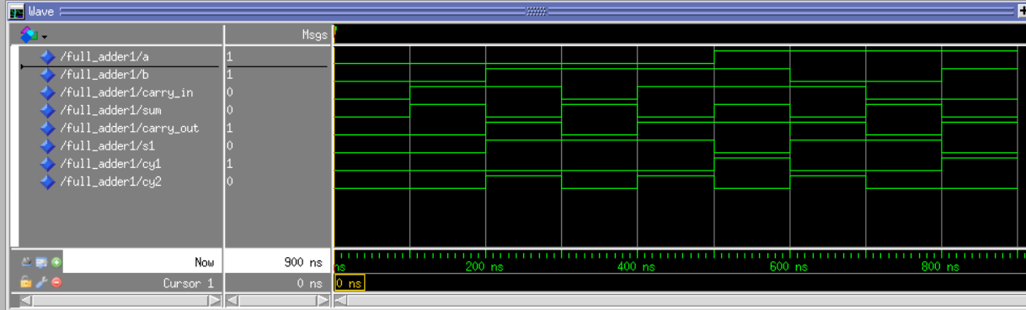
Implemented all basic gates (XOR, AND, NOT and OR)
Half Adder Full Adder

Slide 5
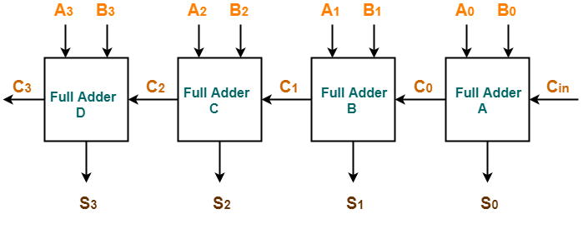
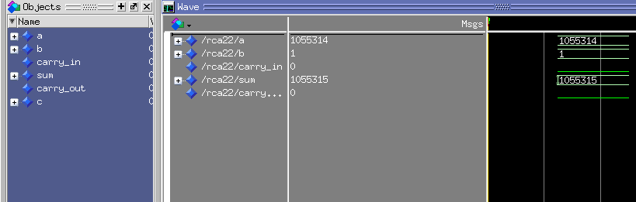
Ripple Carry Adder

Slide 6
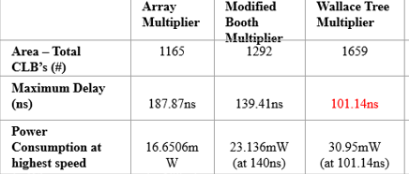
Wallace Tree Multiplier
Compare to Array and Booth Multiplier, Wallace Tree has minimum delay.

Slide 7
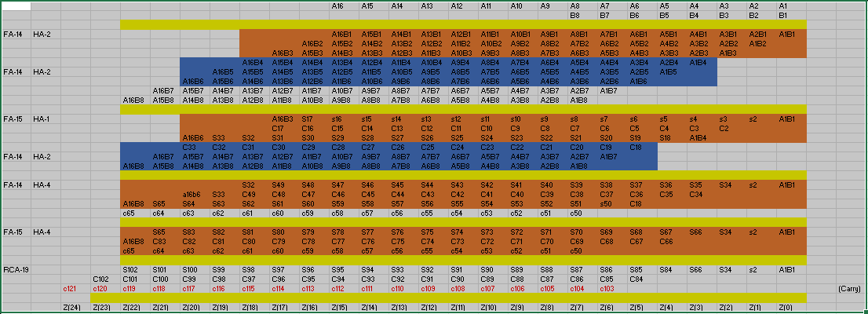
Algorithm(A^2 X B)

Slide 8
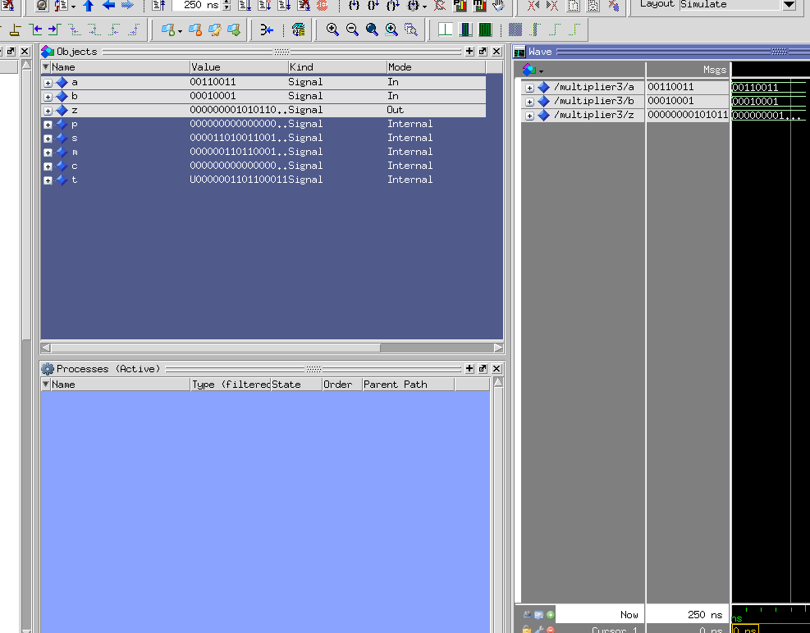
Simulation Result (A^2 X B)

Slide 9
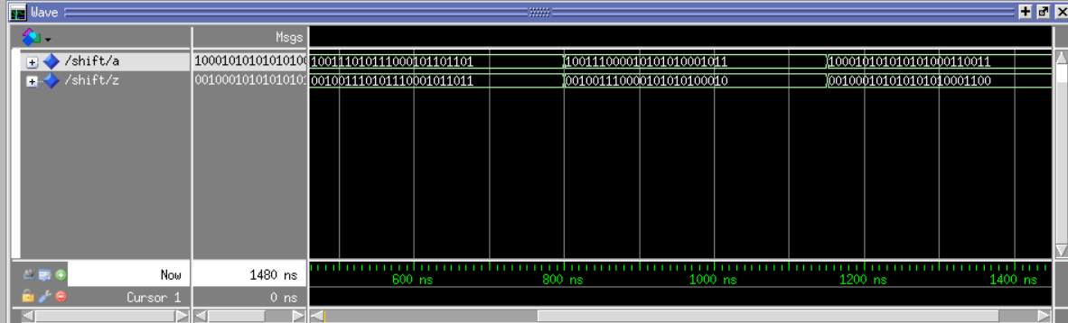
Shift (1/4)

Slide 10
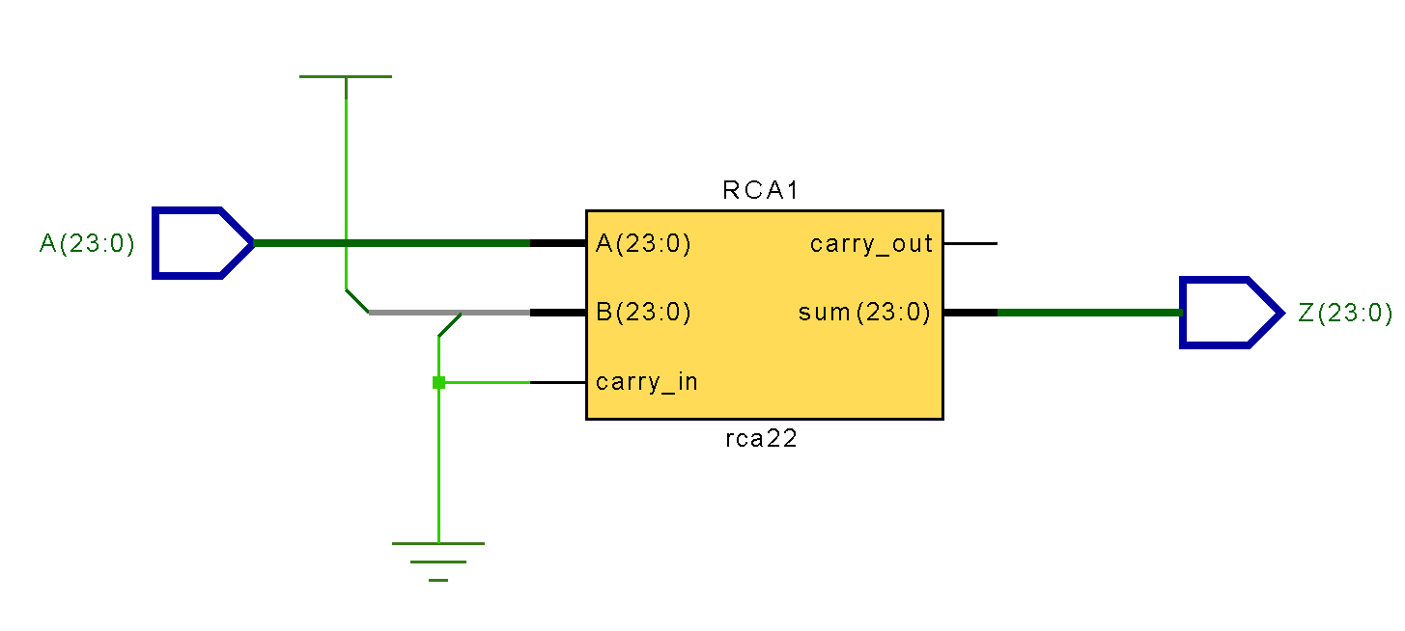
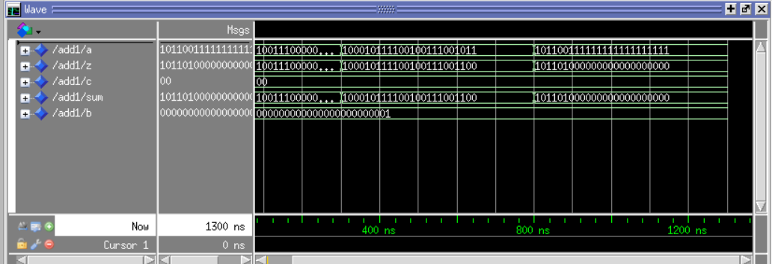
Adding 1

Slide 11
Block Diagram of our workflow
8-bit
A
8-Bit Register
8
16x8(A^2 X B) Multiplication
Shift Register
Adding 1
24-bit Register
8x8(A^B) Multiplication
24
24
24
16
8-Bit Register
Z
B
8-bit
8

Slide 12
Using 8-bit Carry save adder and Full adder
METHOD 2

Slide 13
Modules of the project
2 to 1 Multiplexer
Edge detector
D –Flip Flop
Carry save adder
Full adder
Mult-8
Final top level file

Slide 14
2 to 1 Multiplexer
It is a simple 2 to 1 multiplexer design
We use this module to select the appropriate signal from the full adder

Slide 15
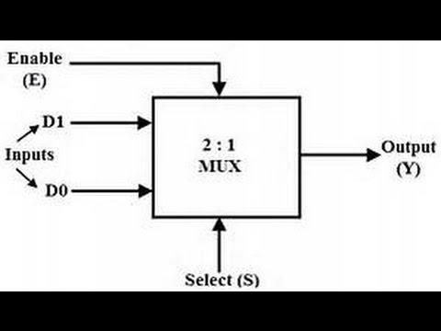

Slide 16
Edge detector
As we know a edge detector is used to determine a change from high to low or vice versa
In our module we used the edge detector to latch the operands when the LOAD signal goes from high to low
This was a bit challenging as we where not able to exactly determine what the error was it took a lot of trial and error to get the necessary result

Slide 17
D- Flip Flop
This is a standard D flip flop used to pipeline the values
There was a major problem in this module
We where not able to get the top level file to detect the variables with std_logic_vector and it repeatedly showing an indexed error.
We then created two modules one with std_logic 1 bit vales and another module with std_logic_vector and instantiated both the modules in the top level file

Slide 18
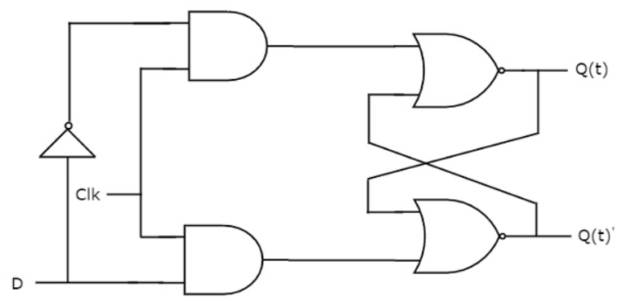

Slide 19
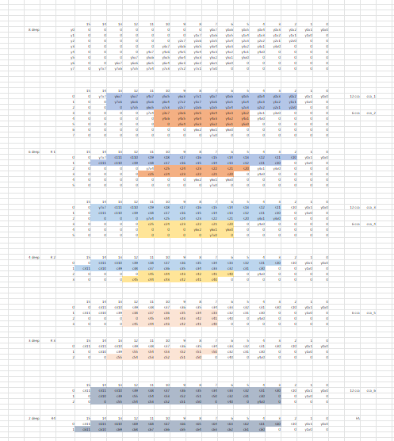
Carry save adder
In our code we have utilized carry save adder
We implemented the multiplier using Wallace tree method
The reduction process in this method Is much simpler when compared to other methods

Slide 20
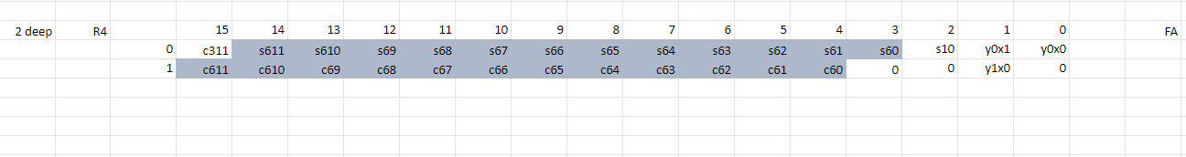
Full adder
The inputs to the full adder are the outputs of the final stage of the carry save adder

Slide 21
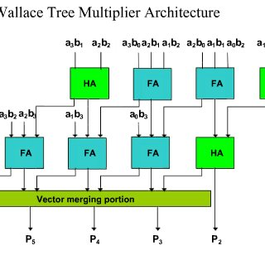
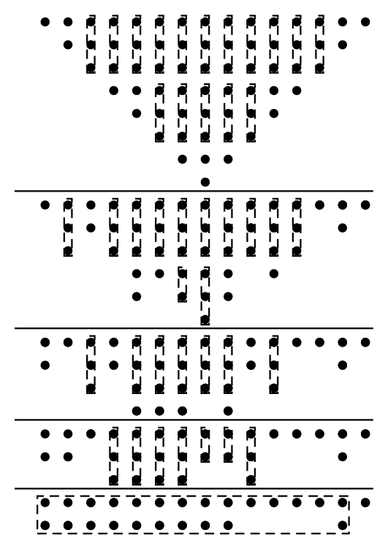
8-bit Multiplier
In this module we declare the carry save adder and the full adder as components
Implementing the instantiation method we implement the module in four stages of reduction
The final stage of the reduction we use a full adder

Slide 22
Top Level project and Test Bench
We used a modular approach in this project
As mentioned earlier we instantiated all the components in the top level file and complied a test bench for that.
We have also pipe lined the top level file using a D- flip flop

Slide 23
Challenges faced
Initially we used a process and for loop in the CSA,FA and MUX module. Even though the code was error free it was very difficult to get the desired waveform. We later on changed it to a generate command
We have used generic maping in the project to make it easier to expand the code for a 16-bit input. It was difficult to understand the declaration and implementation at first.

Slide 24
THANK YOU

